Slide 1

DAXOS
First Presentation
Midhun (47), Nihal (43), Antony (14), Mathew (37)
Guided By Mr. Shibu VS

Slide 2

Contents
01
System Architecture
02
Design Diagrams
Kernel Architecture
Build Process
Use Case Diagram
Activity Diagram
Sequence Diagram
03
Module Details
04
Implementation Plan
kernel.c
tty.c
libc/
VGA text-mode driver
Keyboard driver
Unit Testing Framework

Slide 3

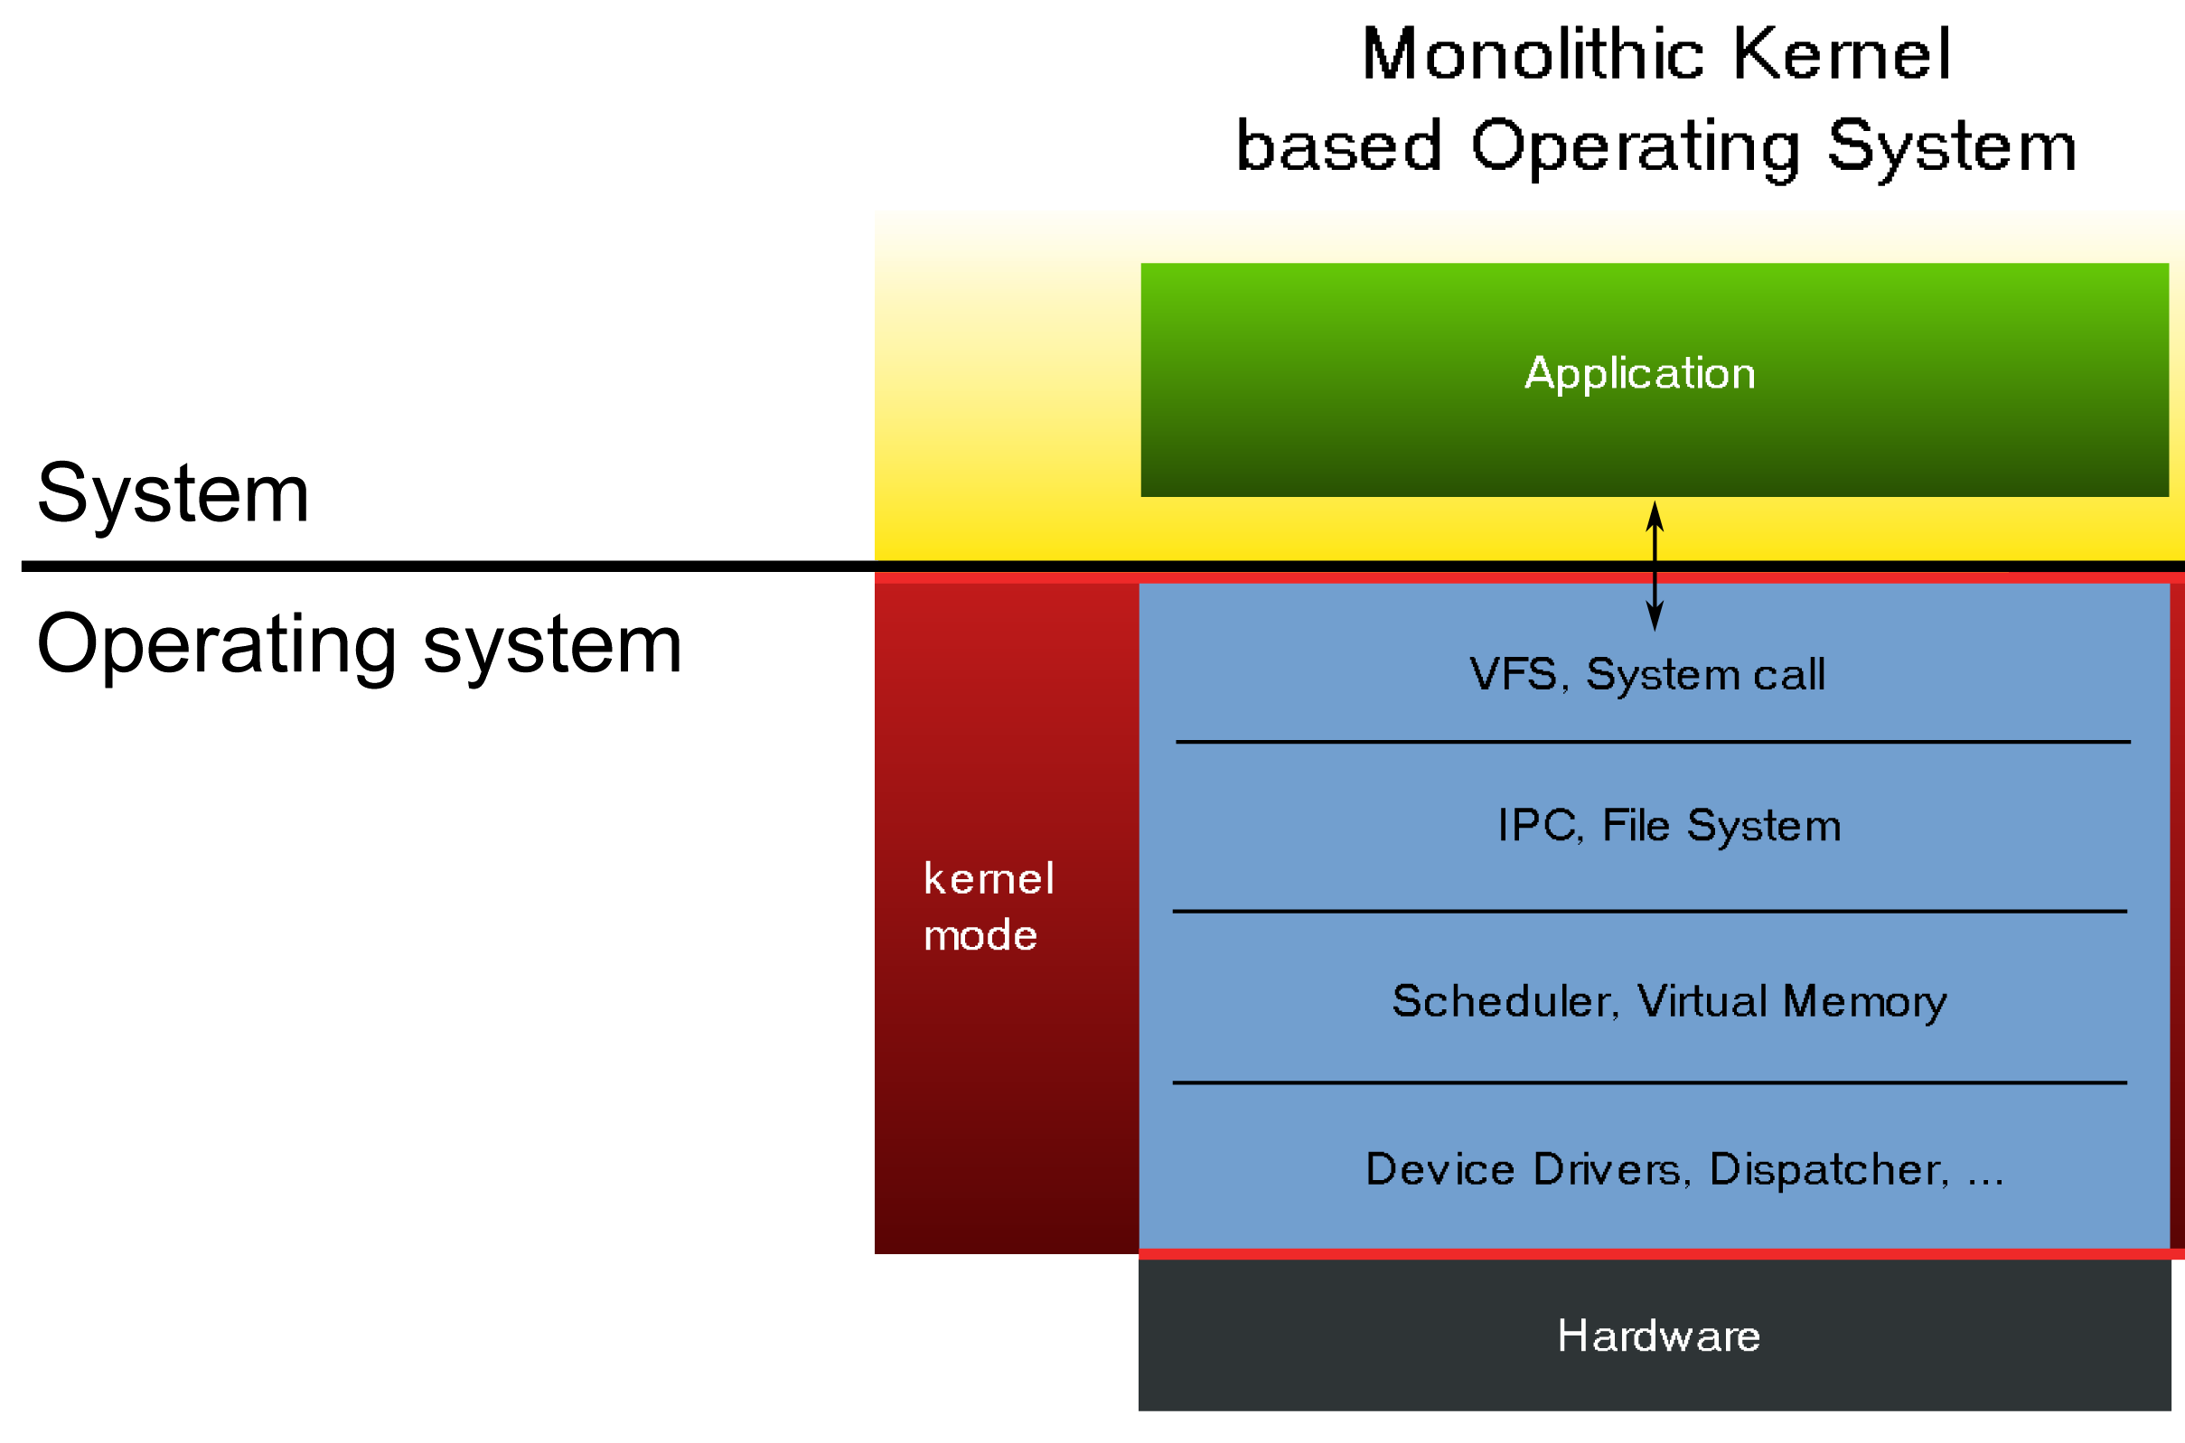
Kernel Architecture
Monolithic Kernel
Drivers, Schedulers and Core programs run in kernel mode with direct access to hardware.
Learning Requires Unrestricted Ring-0 Access

Slide 4




Design of Build Process
GNU Make
GNU Make is a tool which controls the generation of executables and other non-source files of a program from the program's source files.
M
ake
BASH Shell Script
Wrapper/Driver scripts for running and configuring make is written in bash
These include : build.sh, qemu.sh, clean.sh …
B
Q
QEMU
ash
emu
QEMU is a generic and open source machine emulator and virtualizer.

Slide 5
GNU MAKE
OBJS=\
$(ARCHDIR)/crti.o \
$(ARCHDIR)/crtbegin.o \
$(KERNEL_OBJS) \
$(D_UNIT_OBJS) \
$(ARCHDIR)/crtend.o \
$(ARCHDIR)/crtn.o \
.c.o:
$(CC) -MD -c $< -o $@ -std=gnu11 $(CFLAGS) $(CPPFLAGS)
.S.o:
$(CC) -MD -c $< -o $@ $(CFLAGS) $(CPPFLAGS)
DaxOS.kernel: $(OBJS) $(ARCHDIR)/linker.ld
$(CC) -T $(ARCHDIR)/linker.ld -o $@ $(CFLAGS) $(LINK_LIST)
grub-file --is-x86-multiboot DaxOS.kernel
install-kernel: DaxOS.kernel
mkdir -p $(DESTDIR)$(BOOTDIR)
cp DaxOS.kernel $(DESTDIR)$(BOOTDIR)
clean:
rm -f DaxOS.kernel
rm -f $(OBJS) *.o */*.o */*/*.o
rm -f $(OBJS:.o=.d) *.d */*.d */*/*.d
Example
This Makefile generates DaxOS.kernel as output

Slide 6
Design Diagrams
Use-case | Activity | Sequence

Slide 7
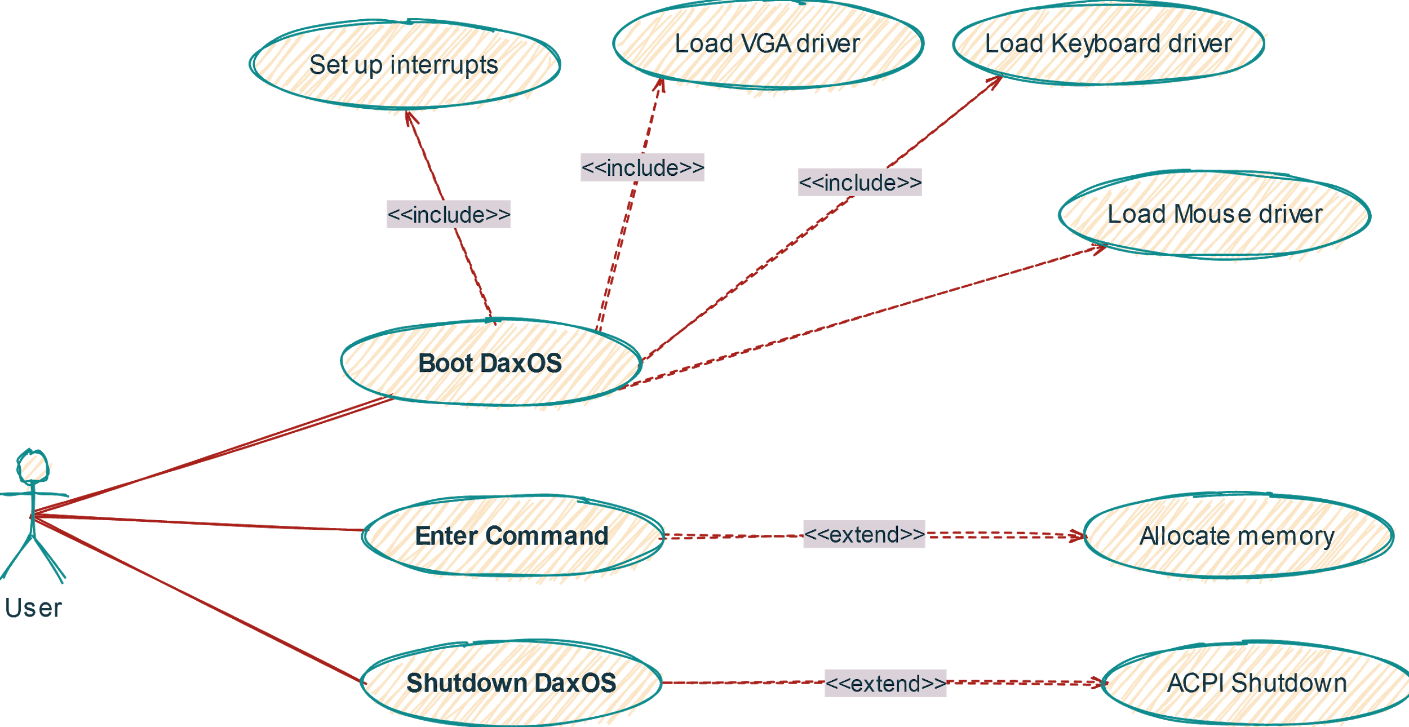
Use Case Diagram

Slide 8
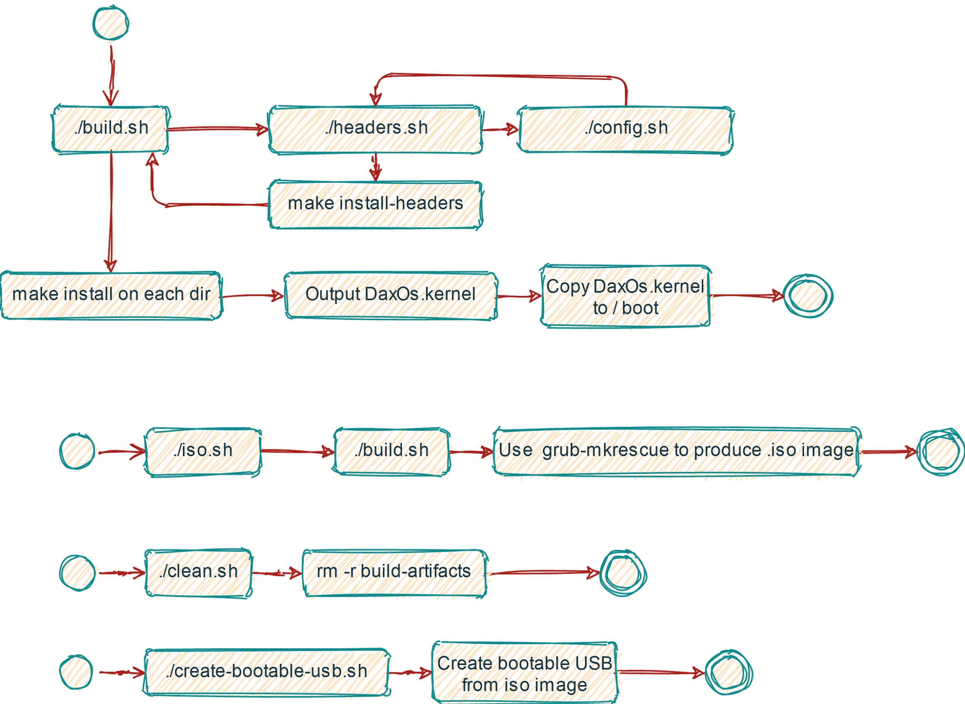
Activity Diagram

Slide 9
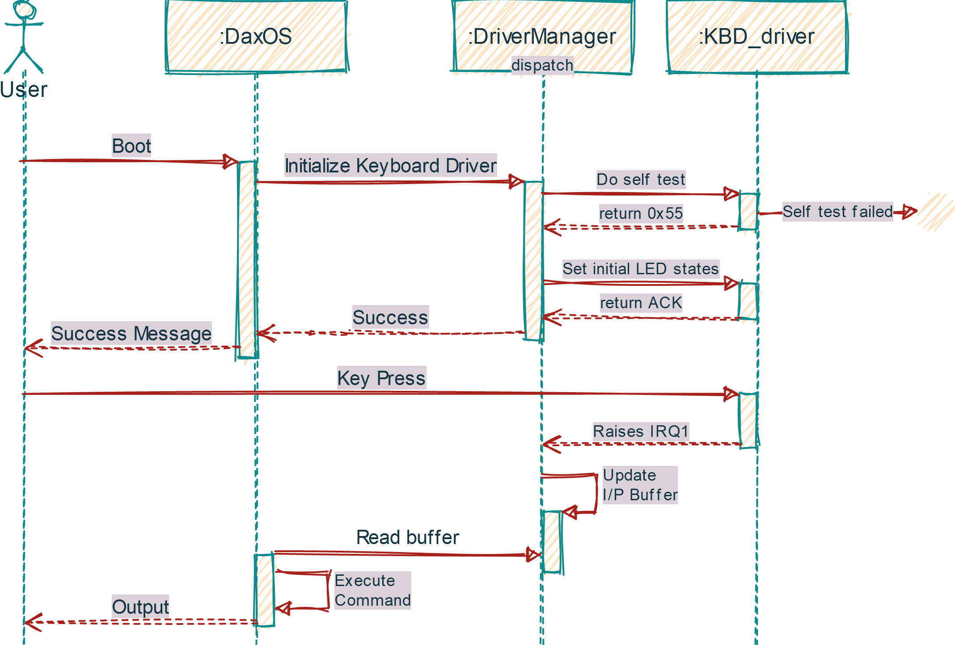
Driver
Sequence Diagram

Slide 10
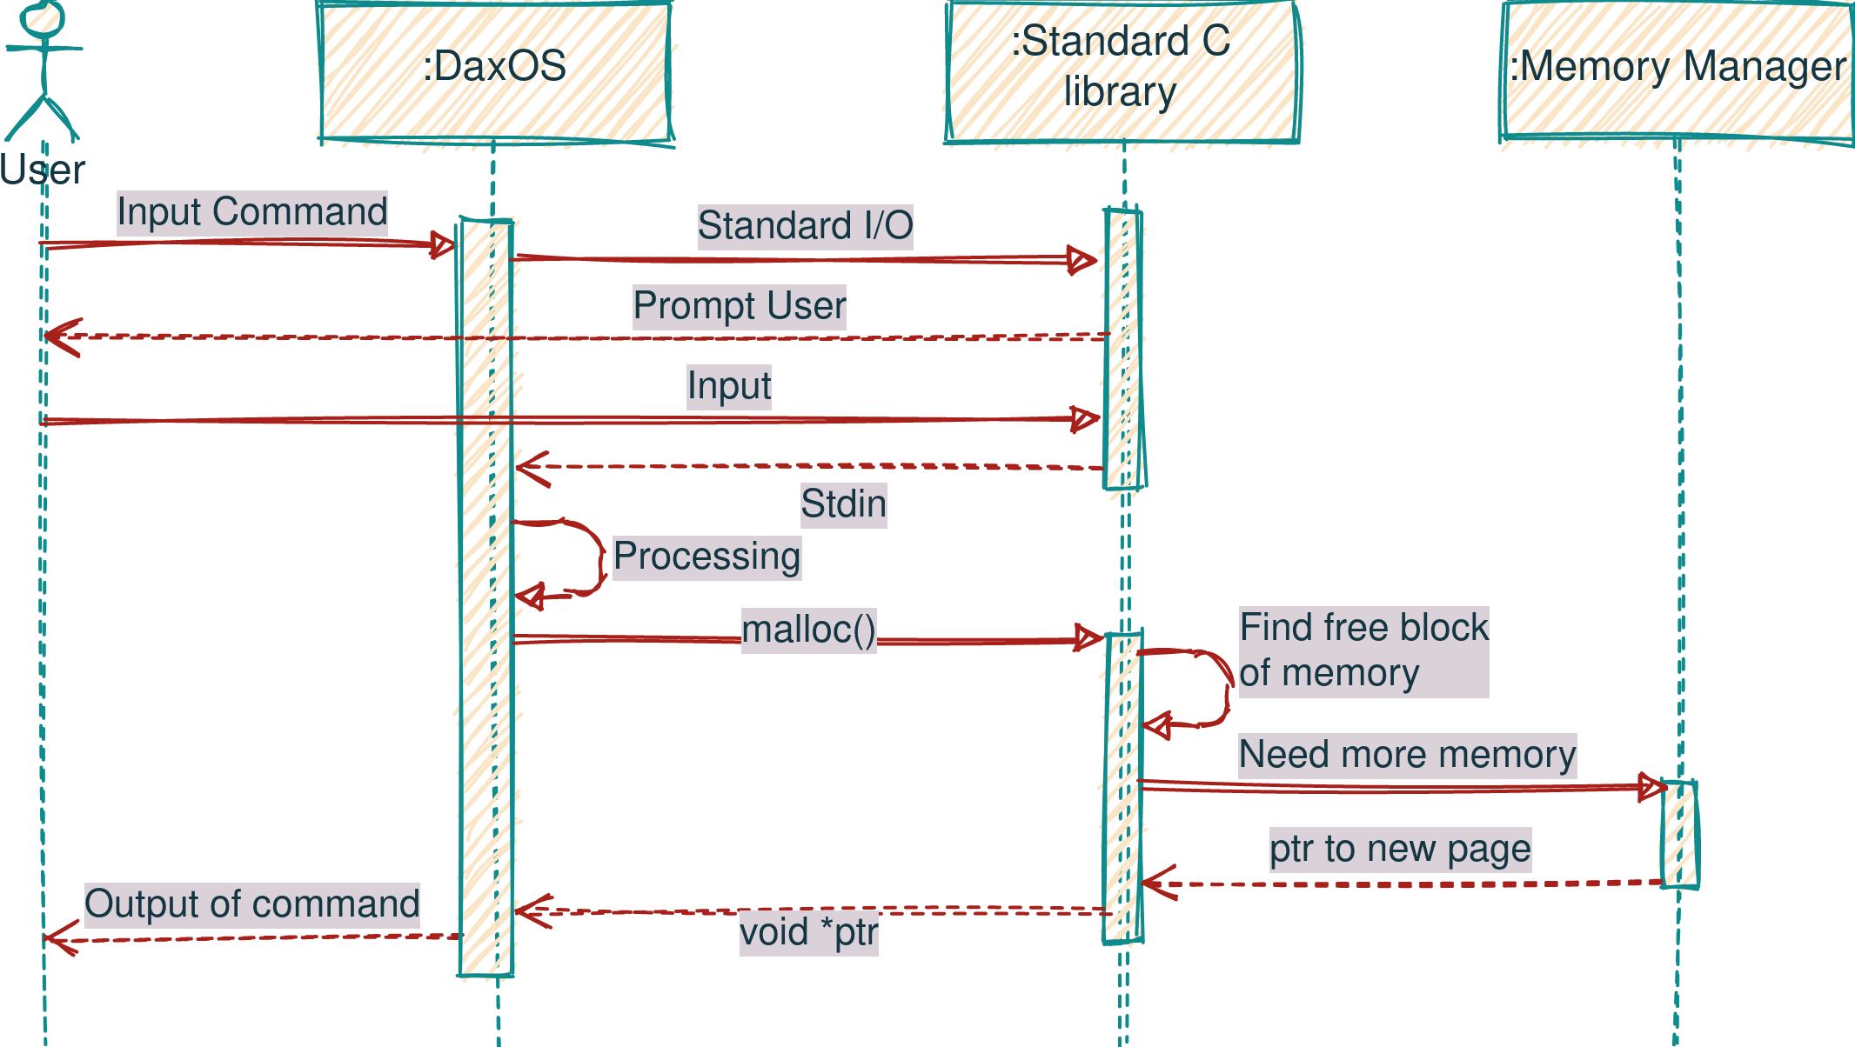
Command
Sequence Diagram

Slide 11
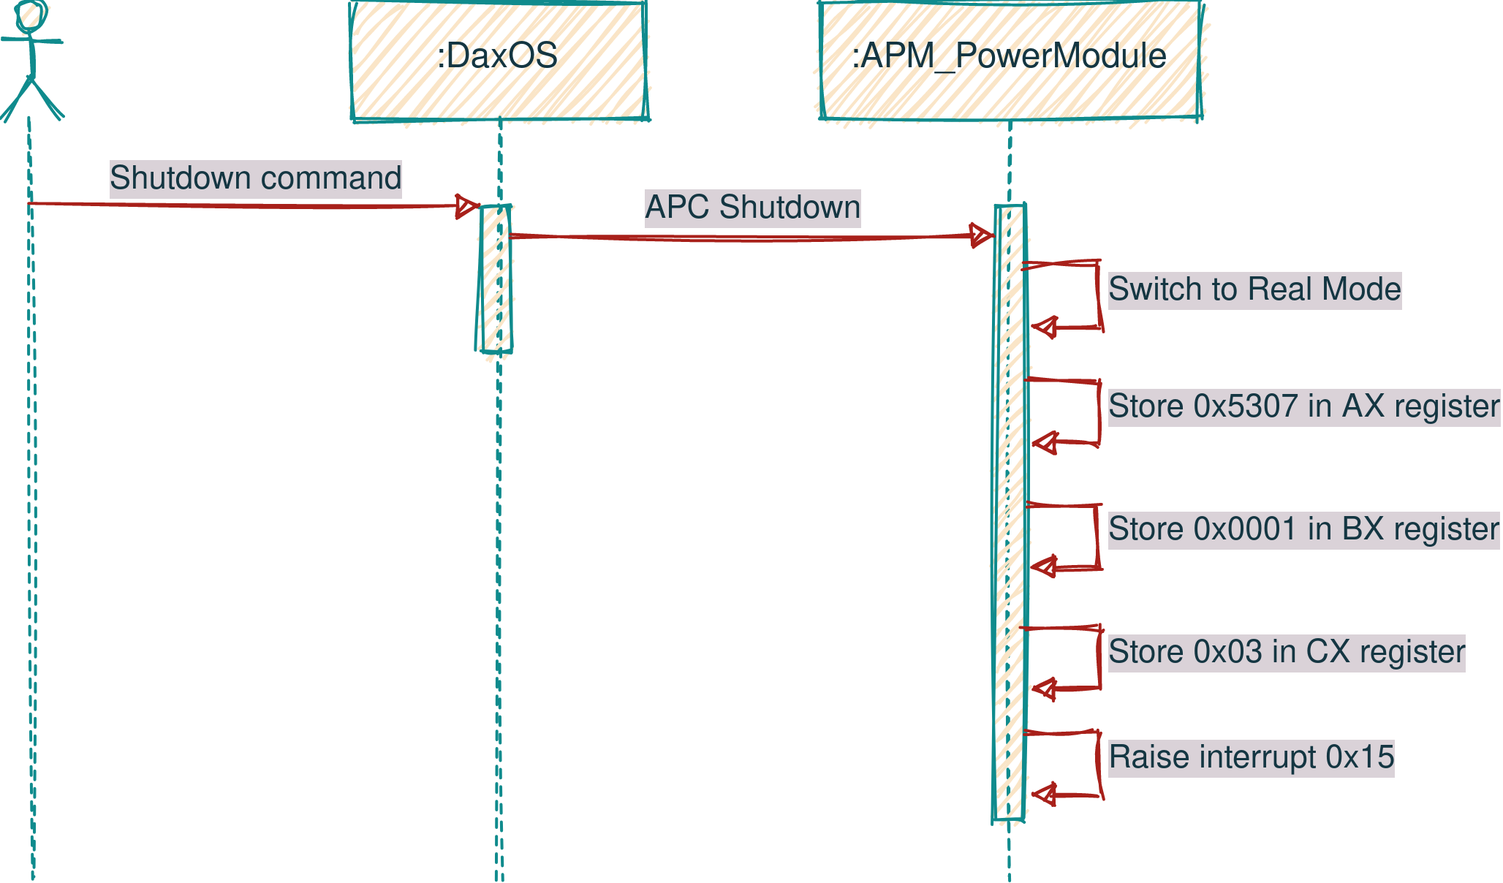
Shutdown
Sequence Diagram

Slide 12

Modules
01
02
03
04
kernel.c
tty.c
io.c
libc/string
Entry point
VGA term
I/O port
String.h
This file drives all other implementations
Display driver
Write and Read from I/O ports
Implements strlen, strncpy, strcpy …

Slide 13


VGA Text-mode driver
Keyboard driver
Print text to screen
Support for printf in stdio.h
Support for 16 bit color
Escape character support
Interrupt based
PS/2 interface
USB keyboard support through emulation
Implementation Goals
For next review
Unit Testing Framework
Custom Testing tooling
No dependency on C library
Made of different kinds of assert
Integrated into the kernel

Slide 14
Thanks !
Documentation & Design Docs can be found at
https://daxkernel.github.io

